Slide 1
Indian Startup Funding Data Analysis
Kwame Otchere • Sept. 2022

Slide 2
Scenario
My team is trying to venture into the Indian start-up ecosystem. As the data expert of the team I am to investigate the ecosystem and propose the best course of action.

Slide 3
Overview
Expected completion
September 16, 2022
Progress so far
Data analysis process complete
Article in progess
Biggest challenges
“Incomplete” records from 2018
Undisclosed details
Amounts
Funding stages

Slide 4
The Dataset
Divided into 4 documents, one each for 2018 – 2021
Common columns:
Company Name
Industry/Sector*
Headquarters/Location*
About
Amount*
Stage
Year of Funding
Year Founded

Slide 5
Ask Phase: Hypothesis
H0: Indian startups that receive most funding are centralized in a few locations & sectors
H1: Indian startups that receive most funding are spread across a variety of locations & sectors

Slide 6
Ask Phase: Main Questions
How has funding to startups changed over the period?
How does location affect funding to startups?
Which sectors are most favoured by investors?
Does the number of deals translate into funding for the sectors?
What is the average amount of funding for start-ups in: the sector with the most funding and the location with the most funding?
How does the breakdown by stages of funding look?
Which start-ups were most favoured by investors?

Slide 7
Process & Preparation Phases
Observations
Undisclosed amounts may affect analyses related to monetary values
Mixed currencies (2018)
Currency signs and commas attached to amounts since all columns are treated as strings
Wrong placement of some information (2021)
Misspellings and use of synonyms
Decisions & Actions
Maintain rows with missing details
Treat missing amounts as zero
Convert all Indian Rupees to US Dollars
Remove all currency signs & commas
Correct placement of misplaced items
Correct misspellings and standardize terms
Group similar sectors

Slide 8
Key Notes
Deals with Disclosed Amounts: 2,310
Primary Columns
Total Deals: 2,858
Unique Companies: 2,151
Unique Sectors: 203
Unique Cities: 132
Other Columns
Unique Stages/Rounds: 39
Years Founded: 34
Founders: 1,790
Investors: 1,246

Slide 9
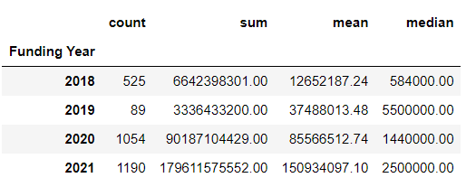
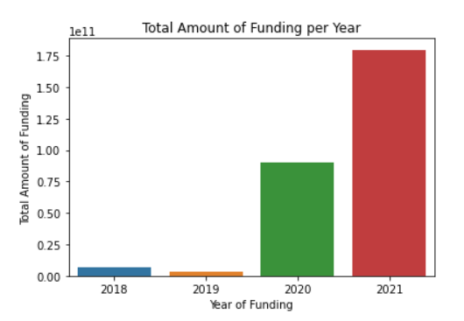
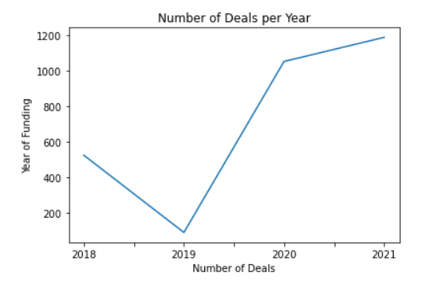
How has funding to startups changed over the period?

Slide 10
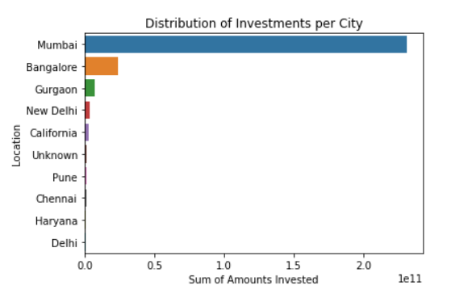
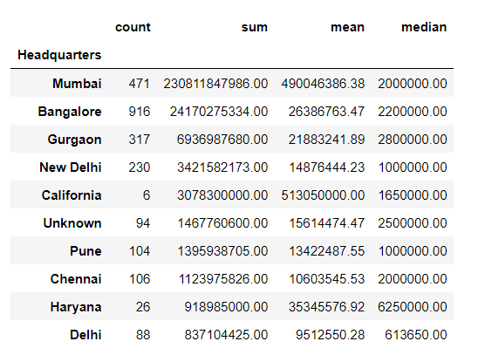
How does location affect funding to startups?

Slide 11
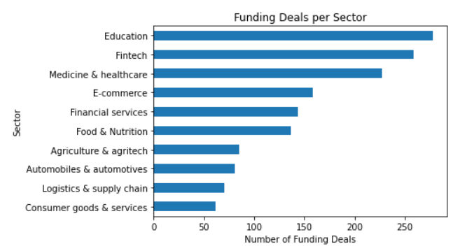
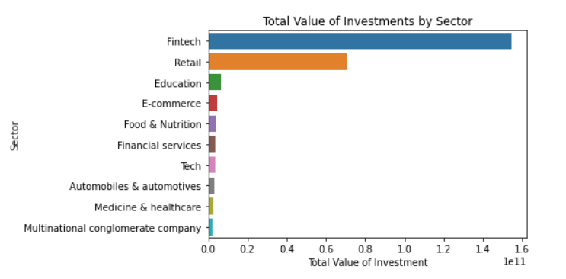
Which sectors are most favoured by investors?

Slide 12
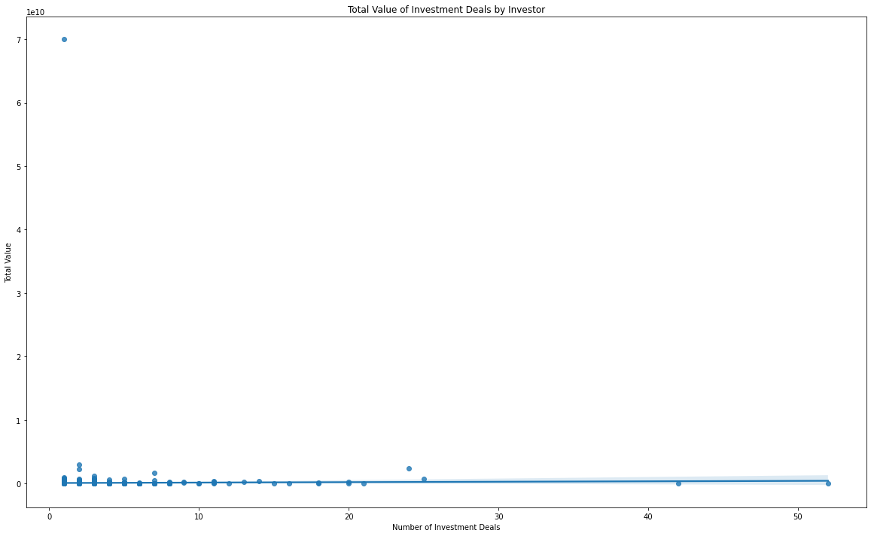
Does the number of deals translate into funding for the sectors?
No!

Slide 13
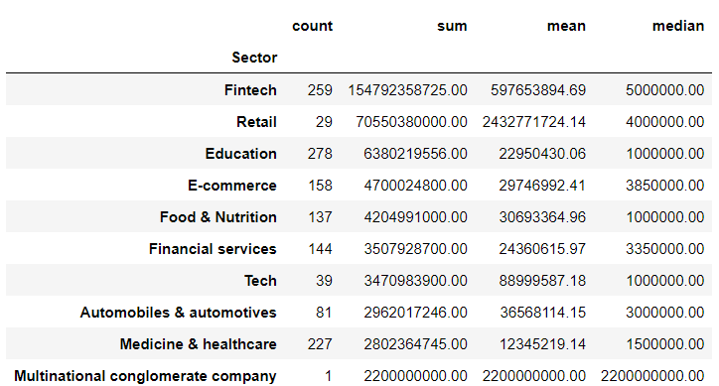
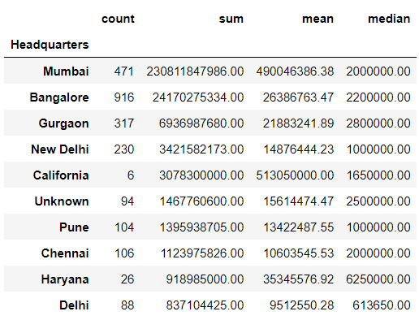
What is the average amount of funding for start-ups in: the sector with the most funding and the location with the most funding?
Mumbai-based startups and startups based in the Fintech sector got the most funding on average per deal
Notes:
Sector: 597m, and Location: 490m

Slide 14
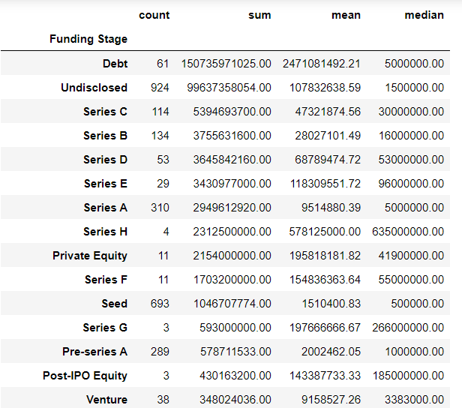
How does the breakdown by stages of funding look?
Debt funding is the most common type of funding
The average startup receives USD 1.51 billion per deal in the Seed round

Slide 15
Which start-ups were most favoured by investors?
By Number of Deals:
Byju’s 10
Bharatpe 10
Zomato 7
Nykaa 6
Trell 6
Zetwerk 6
Vedantu 6
Oyo 6
Mpl 6
Spinny 6
By Amounts Invested:
Alteria capital | 150,000,000,000.00
Reliance retail ventures ltd | 70,000,000,000.00
Snowflake | 3,000,000,000.00
Byju's | 2,522,000,000.00
Reliance | 2,200,000,000.00
Swiggy | 1,956,000,000.00
Oyo | 1,665,000,000.00
Verse innovation | 1,550,000,000.00
Dream sports | 1,240,000,000.00
Zomato | 1,239,000,000.00
Byju’s & Bharatpe were involved in most deals
Alteria Capital and Reliance Retail Ventures received most funding

Slide 16
Conclusion: Hypothesis
With the foregoing in mind, it is safe to accept the null hypothesis, given that funding to startups over the period was centralized around:
particular locations (Mumbai and Bangalore) and
particular sectors (Fintech and Retail)

Slide 17
Recommendations to the Team
Prioritize a Mumbai-based FinTech. Other considerations are as follows:
Sectors to prioritize:
retail, and
education
Cities to prioritize:
Mumbai and
Gurgaon
Likeliest source of funding:
Debt (may come with conditionalities)
Series C
Series B.
Additional Note: an average startup gets an average of about USD 1.5m at the Seed round.
Seek alternative sources of funding during the early years, as funding comes in after a year or two of establishment.

Slide 18
Next steps
Article
Complete and upload on Medium
GitHub
Upload notebook and datasets on GitHub

Slide 19
Questions

Slide 20
Thank You

